Slide 1
ELECTICITY USAGE ANALYSIS
DONE BY
NARESH.S

Slide 2
Objective of the project
This project focuses on analyzing electricity consumption patterns across different households over time using SQL.
The aim is to provide insights into monthly power usage rank households based on their consumption, and automate parts of the billing process.
The project involves:
Updating billing status (High, Medium, Low) using conditional logic
Ranking households by electricity usage within each year and month
Creating pivot tables to show monthly usage trends
Calculating average usage and comparing it with actuals
Fetching temperature and AC usage details for high-consumption homes
Using stored procedures to retrieve region-wise or household-wise usage
Implementing triggers to auto-calculate billing cost during data insertion

Slide 3
Datasets
Appliance_usage
Billing_info
Calculated_metrics
Environmental_data
Household_info

Slide 4
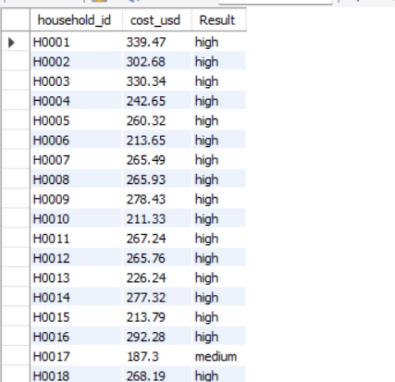
Project Task 1: Update the payment_status in the billing_info table based on the cost_usd value. Use CASE...END logic.
Query:
update billing_info set payment_status=
(case when cost_usd>200 then "high"when cost_usd>100 and cost_usd <=200 then "medium"else "low"end);
Output:

Slide 5
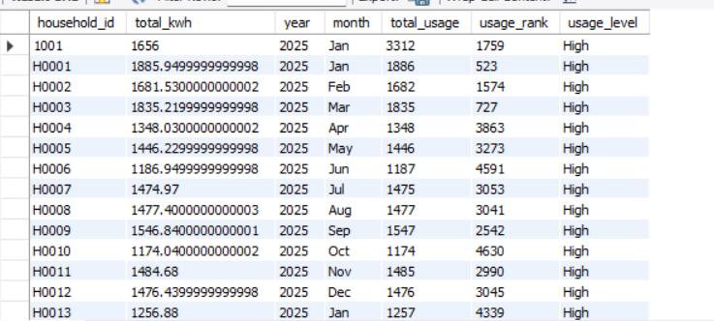
Project Task 2: (Using Group by) For each household, show the monthly electricity usage, rank of usage within each year, and classify usage level
Query:
select household_id, total_kwh, year, month,round(sum(total_kwh)) as total_usage,
rank() over(order by total_kwh desc) as usage_rank,
case when round(sum(total_kwh)) > 500 then 'High’
else 'Low’ end as usage_level from billing_info group by household_id, year, month,total_kwh order by household_id;
Output:

Slide 6
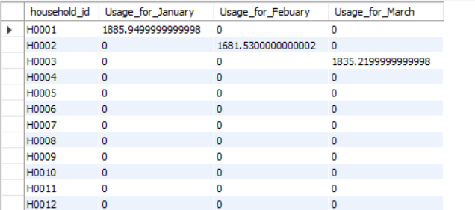
Project Task 3: Create a monthly usage pivot table showing usage for January, February, and March
Query:
select household_id,sum(case when month='Jan' then total_kwh else 0 end) as Usage_for_January,
sum(case when month='Feb' then total_kwh else 0 end) as Usage_for_Febuary,
sum(case when month='Mar' then total_kwh else 0 end) as Usage_for_March from billing_info group by household_id;
Output:

Slide 7
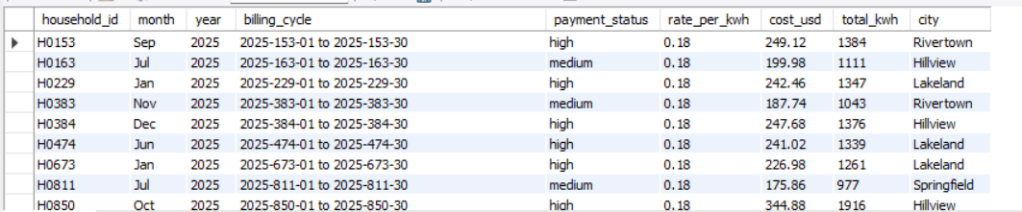
Project Task 4: Show average monthly usage per household with city name
Query:
select B.*,H.city from billing_info B inner join hh_info H on B.household_id=H.household_id
where total_kwh in (select round(avg(total_kwh)) as Avg from billing_info group by household_id)
order by household_id asc;
Output:

Slide 8
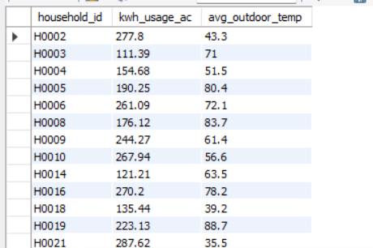
Project Task 5: Retrieve AC usage and outdoor temperature for households where AC usage is high
Query:
select A.household_id, A.kwh_usage_ac,E.avg_outdoor_temp from app_usage A inner join env_data E on A.household_id=E.household_id where kwh_usage_ac in (select kwh_usage_ac from app_usage where kwh_usage_ac>100);
Output:

Slide 9
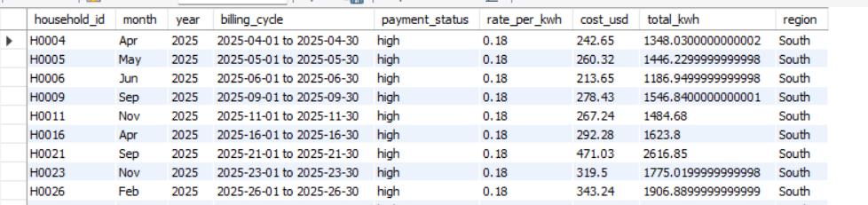
Project Task 6: Create a procedure to return billing info for a given region
Query:
create table combined as select B.*, H.region from billing_info B inner join hh_info H on B.household_id=H.household_id;
delimiter !!
create procedure regn(in region_name varchar(100))
beginselect * from combined where region = region_name;
end !!
delimiter ;
call regn('south');
Output:

Slide 10
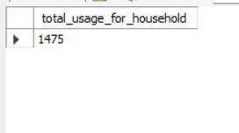
Project Task 7: Create a procedure to calculate total usage for a household and return it
Query:
create procedure sum_usage(in inp_hh_id varchar(50), inout final_usage double)
Begin
select round(sum(total_kwh)) into final_usage from billing_info where household_id=inp_hh_id;
end !!
delimiter ;
set @final_usage= 0;
call sum_usage('H0007', @final_usage);
select @final_usage as total_usage_for_household;
Output:

Slide 11
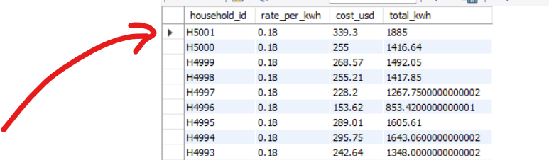
Project Task 8: Automatically calculate cost_usd before inserting into billing_info
Query:
delimiter !!
create trigger cost_usd_update before insert on billing_info for each row
begin
set new.cost_usd=new.total_kwh * new.rate_per_kwh;
end !!
delimiter ;
insert into billing_info(household_id, rate_per_kwh, total_kwh) values ('H5001', 0.18, 1885);
select household_id, rate_per_kwh, cost_usd, total_kwh from billing_info order by household_id desc;
delete from billing_info where household_id='H5001';
Output:

Slide 12
THANK YOU

